Slide 1
Practical Programming
Baseline
KS4M1L1

Slide 2
Baseline
You need to write python programs and test them over this lesson.
There is 3 main tasks. Silver, Gold and Platinum. Each is progressively harder.
If you wish to skip over Silver and start from Gold you may do so
You will need to upload ALL you program code to the assignment at the end (even if incomplete)
Make sure you clearly mark which code is for which assignment
In addition complete the Google survey indicating which questions you attempted
This is an "open book" assessment so you can use the internet to help you with finding the correct commands and you can also refer back to work you did last year
I will also provide a knowledge sheet from last years Python unit
You can also use myself / Miss Davis for help

Slide 3
Silver
Complete the following Python challenge cards (see next slide)
Challenge 2
Challenge 3
Challenge 6
Challenge 9

Slide 4
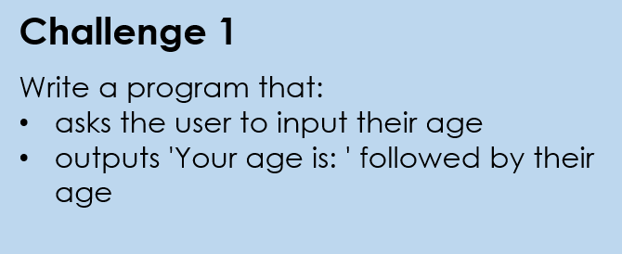
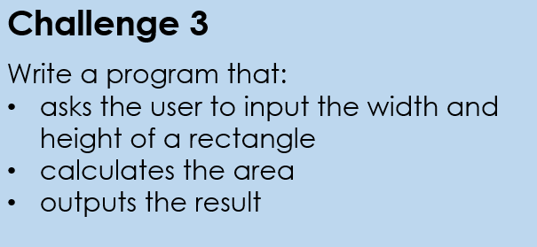
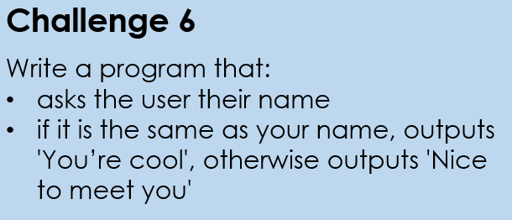
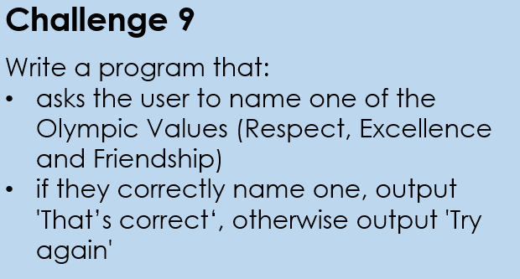
Silver

Slide 5
Silver 2
Write a program to
Ask the user to enter a number
Output the timetable for that number from 0 to 12
The times table output should be well formatted so appears as
0 x 5 = 0
1 x 5 = 5
.. up to ..
12 x 5 = 60

Slide 6
Gold - 1
Arithmetic test
You have to write a program to run a random maths quiz.
It should ask 10 questions each time it is run. Each question should consist of a simple sum which is either addition, subtraction or multiplication (randomly) and 2 numbers between 5 and 50.
If should check the answer and give a final score
Random Number
To generate random numbers in Python you need to add the random library putting this command as your FIRST line of code
import random
You can then use the command
number=random.randint(1,3) to get a random number between 1 and 3 and store it in a variable called number
Example code to try
import random
num1 = random.randint(1, 5)
num2 = random.randint(1, 6)
print(num1)
print(num2)

Slide 7
Gold - 2
Number Table
Write a program that takes a symbol (+,-, or *) and a natural number (>0) and makes a table like below for the operation from 0 to n.
For this example the user has entered “+ 4”
Python help - challenge
In this program ideally you want to allow the user to enter + 4 on a single line rather than 2 separate inputs. To do this you need to split the user input into 2 separate text strings.
Python allows you to do this using [start : end] where start and end are integers; try this code to see how it works
str1="hello"
print ( str1[0] )
print ( str1[2:4])
print ( str1 [2:] )
print( str1 [:2] )
+ | 0 1 2 3 4
-------------------
0 | 0 1 2 3 4
1 | 1 2 3 4 5
2 | 2 3 4 5 6
3 | 3 4 5 6 7
4 | 4 5 6 7 8

Slide 8
Platinum - 1
Factors
Create a program that asks the user to enter an integer and then displays all the factors of that integer
The program should also output whether the number is PRIME or not so either
"The number …. is Prime" or
"The number …. is not Prime" or
Sample output
Your number is 12, its factors are
1
2
3
4
6
12
The number 12 is not Prime
Modulus operator
The modulus operator will return the REMAINDER following an integer division. Python uses the % symbol as as the modulus operator.
So
6 % 4 is 2 as 6 divided by 4 is 1 remainder 2
6 % 3 is 0 as 6 divided by 3 is 2 remainder 0

Slide 9
Platinum - 2
Fizz Buzz
Create a program that replicates the famous game Fizz Buzz. The program will take an input, e.g. 20, and then print out the list of Fizz Buzz up to and including that number, where:
• Any multiple of 3 is replaced by the word ‘Fizz’
• Any multiple of 5 is replaced by the word ‘Buzz’
• Any multiple of both 3 and 5 is replaced by the word ‘FizzBuzz’
Extension:
1. Replace any prime number with the word ‘OOPS!’
2. Allow the user to enter the base numbers that they want to replace words with. E.g. 2 and 3, which would mean:
• Any multiple of 2 is replaced by the word ‘Fizz’
• Any multiple of 3 is replaced by the word ‘Buzz’
• Any multiple of both 2 and 3 is replaced by the word ‘FizzBuzz’
Sample output
Your number is 16,
1
2
Fizz
4
Buzz
Fizz
7
8
Fizz
Buzz
11
Fizz
13
14
FizzBuzz
16

Slide 10
Platinum - 3
Write a program that calculates the area of various regular polygons. The program should include an initial menu that asks them what shape they want the area of. Once they have selected this it should then ask them to input the key dimensions required eg
Rectangle = length and width
Triangle = base and height
You should include (at least)
Square, triangle, circle, rectangle, parallelogram, regular hexagon (you may need to google this!),
After displaying the answer the program should return to the initial menu. The menu should include a quit option

